Slide 1

Kent State University Advanced Machine Learning Final Project Melanoma Detection Using Deep Learning
Aishwarya Lingam
811321442

Slide 2
Goal & Objective
Goal
Build a deep learning model to classify skin lesions as benign or malignant, aiding early melanoma detection
Objective
Fine-tuning a ResNet50 model, boost accuracy with data augmentation, and use Grad-CAM to visualize predictions.

Slide 3
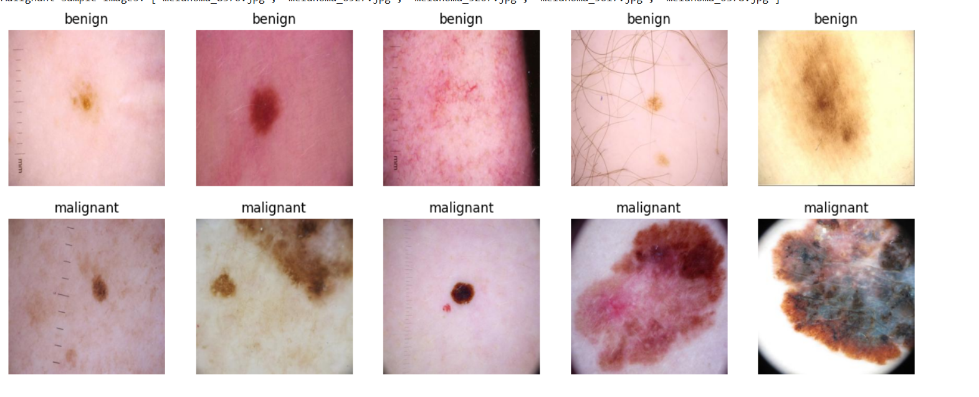
Dataset & Preprocessing
Dataset:
10,000 labeled skin images for benign and malignant cases.
Used 9600 images for training and 1000 images for evaluation of model.
Preprocessing:
Resized to 224x224 pixels
Normalized pixel values
Applied data augmentation (flip, rotate, zoom)
Train-validation-Test split for model evaluation

Slide 4
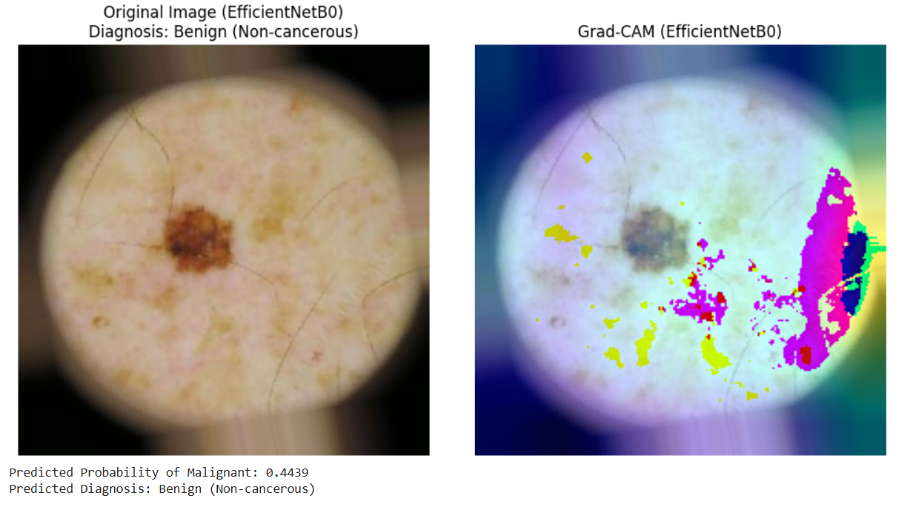
Model & Training
Model
Used ResNet50 with transfer learning and added custom layers for melanoma classification.
Grad-CAM used for visualizing model focus on lesions.
Training
Trained with binary cross-entropy loss and Adam optimizer.
Applied data augmentation and fine-tuned top ResNet50 layers for better accuracy.

Slide 5
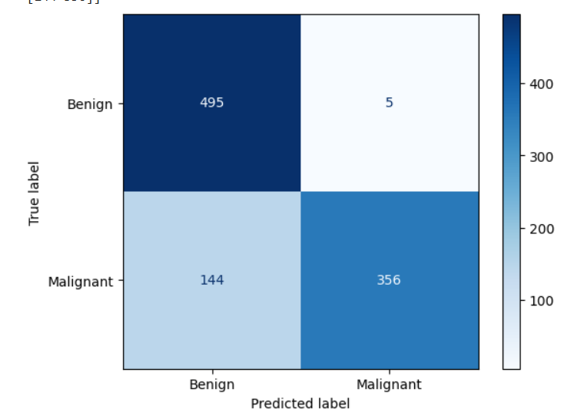
Results & Evaluation
Metrics:
Accuracy: 67.1%
AUC Score: 0.8901
Precision / Recall: Balanced overall, but high precision (0.99) for malignant cases and lower recall (0.35)
Evaluation:
Confusion Matrix: Showed the model correctly identified most benign cases, but missed many malignant ones
Classification Report: Highlighted strong precision but moderate overall performance, with an F1-score of 0.63

Slide 6
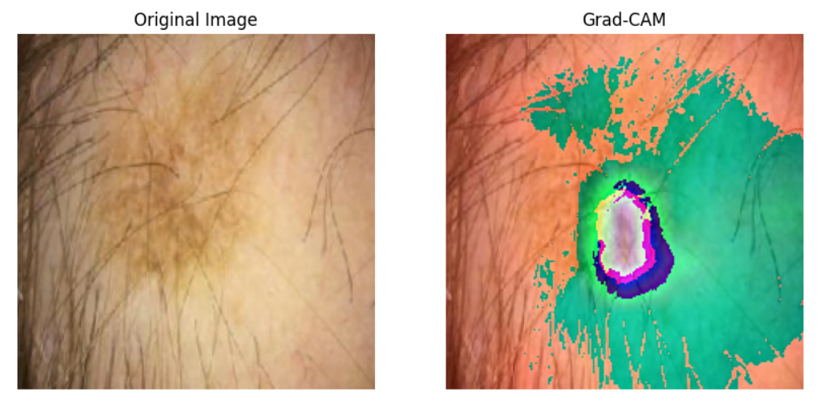
Interpretability with Grad-CAM
Purpose:
To identify which areas of the skin lesion images the model considers most important when predicting whether a case is benign or malignant.
Result:
Grad-CAM shows that the model focuses on key lesion areas in malignant cases, helping users understand and trust its predictions.
Next Step:
Include a Grad-CAM example image in the final version to visually demonstrate this focus.

Slide 7
Conclusion & Future Work
Summary:
ResNet50 model gave high AUC (0.89) and strong precision for melanoma detection.
Deep learning supports early and accurate cancer diagnosis.
Future Work:
Improve recall and handle class imbalance.
Use larger, more diverse datasets.
Explore Vision Transformers and add explainable AI tools.

Slide 8
Thank you

